Slide 1
Creating a Raiser’s Edge Connection
Directions for Setting up Remote Desktop Connection to Raiser’s Edge for Windows
7/22/16

Slide 2
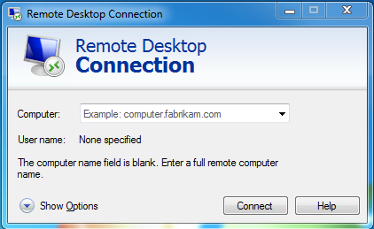
To create a new shortcut For PCs:
Open the Start Menu
In the search field, type Remote Desktop
Click on the Remote Desktop Connection program
You will see the window pictured to the right
Click the Show Options dropdown.

Slide 3
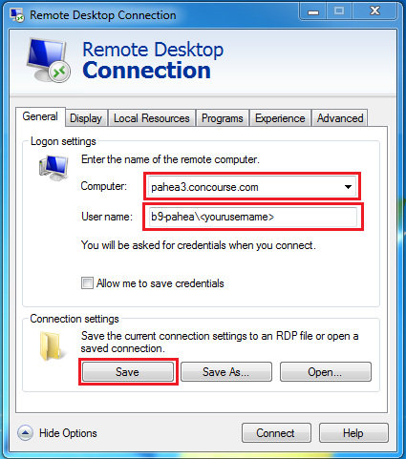
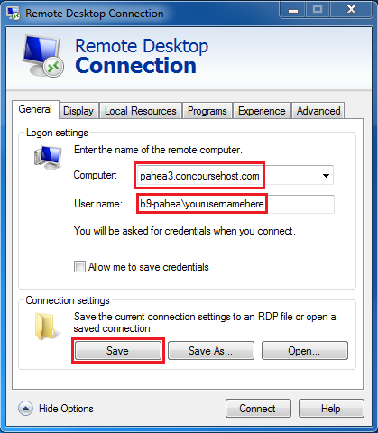
In the General tab:
In the Computer: field, white in pahea3.concoursehost.com
Enter your username, preceded by b9-pahea\
Click the Save button in the lower left, and save the shortcut to your desktop with the name Raiser’s Edge
Then click the display tab

Slide 4
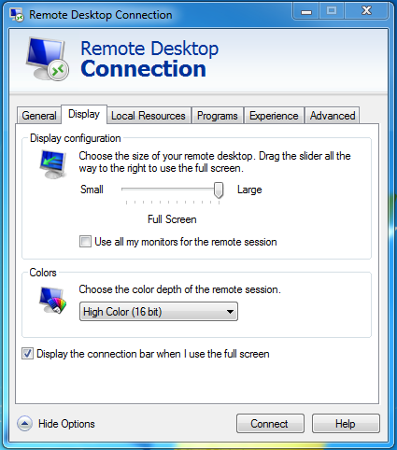
In the Display tab:
Set the Display configuration is set to the largest setting
Do not use all monitors for the remote session
For Colors, choose High Color (16-bit) from the dropdown menu
Select the “Display the connection bar” option
Then click the Local Resources tab

Slide 5
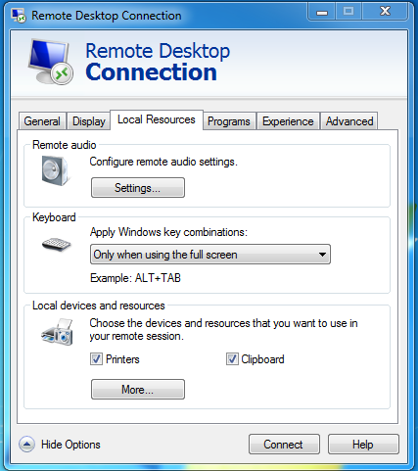
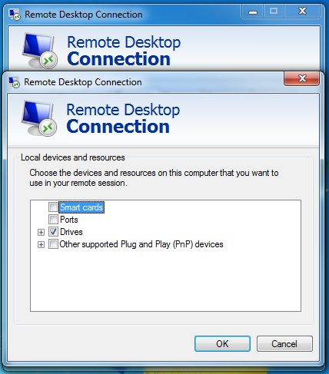
In the Local Resources tab:
At the bottom, click More
Unselect Smart cards
Select Drives
Click OK
Move on to the Experience tab

Slide 6
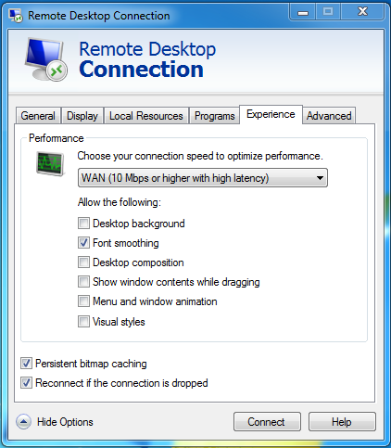
In the Experience tab:
Click the dropdown menu and choose WAN (10 Mbps or higher with high latency)
Unselect all but the second of the check boxes below
Return to the general tab, click save, and click connect.

Slide 7
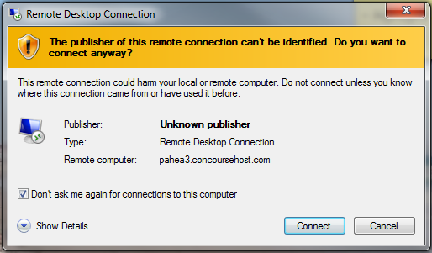
To finish connecting:
You will be prompted to confirm the connection.
Before clicking “Connect” in the lower right corner, make sure to mark the “Don’t ask me again for connections to this computer” check box in the lower left.

Slide 8
Additional Notes
New users will automatically be prompted to set a new password. The password must contain at least eight characters, Upper- and lower-case letters, a number, and a special character (such as !@#$%^&*)
To launch the Raiser’s Edge connection in the future, either double click the shortcut placed on your desktop, or launch Remote Desktop Connection from the Start Menu.

